Slide 1
Framework for recommendation system

Slide 2
Abstract-
Recommendation systems attempt to predict the preference or rating that a user would give to an item.
Knowledge discovery techniques can be applied to the problem of making personalized recommendations about items or information during a user's visit to a website. Collaborative Filtering algorithms give recommendations to a user based on the ratings of other users in the system.
Traditional collaborative filtering algorithms face issues such as scalability, sparsity and cold start. We are here to bring a common platform for including libraries and multiple toolsets to combine and ease developer’s work.

Slide 3

A number of frameworks for Recommender Systems (RS) have been proposed by the scientific community, involving different programming languages, such as Java, C\#.
Python, among others. However, most of them lack an integrated environment containing clustering and ensemble approaches which are capable to improve recommendation accuracy. On the one hand, clustering may support developers to pre-process their data to optimize or extend recommender algorithms. On the other hand, ensemble approaches are efficient tools to combine different types of data in a personalized way.

Slide 4
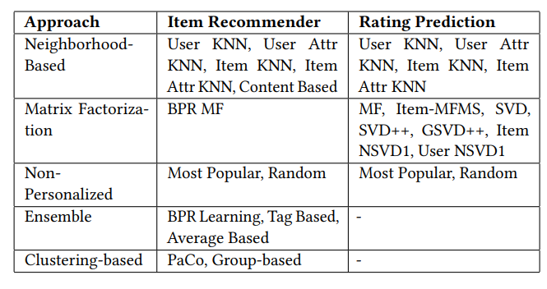
The framework is now implemented in Python 3 and it addresses two common scenarios in recommender systems: rating prediction and item recommendation, using explicit, implicit or both types of feedback in several recommender strategies.
easy_install CaseRecommender
or alternatively: pip install CaseRecommender

Slide 5
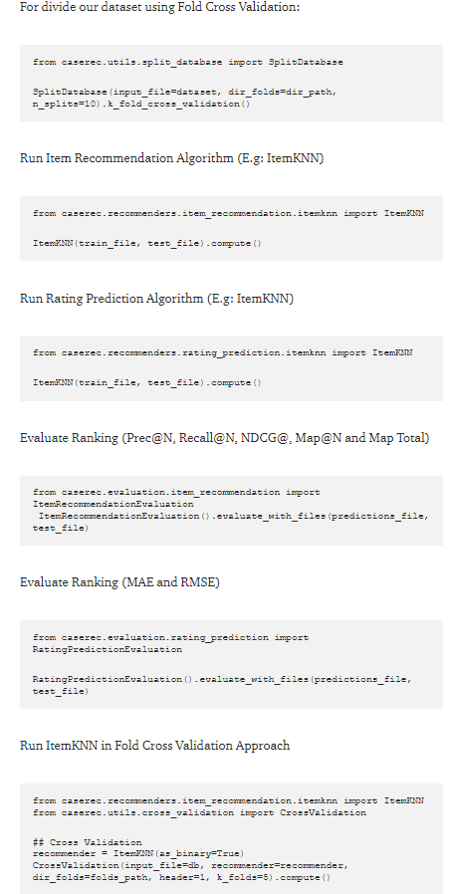
Usage-
During my studies, we also built a repository of a topic-centric public data sources in high quality for RS. They are collected and tidied from Stack Overflow, articles, recommender sites and academic experiments. Most of the datasets presented in the repository are free, having open source licenses.

Slide 6


Input Data-
The framework allows developers to deal with different datasets and not having to develop their own programs to execute recommender functions. The input of algorithms expects the data to be in a simple text format:
user_id item_id feedback
where user_id and item_id are integers referring to users and items IDs, respectively, and feedback is a number expressing how much the user likes an item or binary interaction. The separator between the values can be either spaces, tabs, or commas. If there are more than three columns, all additional columns are ignored. For example, here is a sample of data from the ML100k dataset:

Slide 7
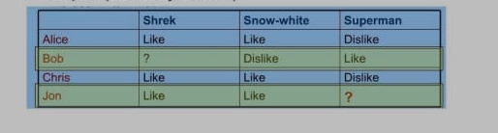
Case Study
1) As we can see from the table when the data is increased the model will be trained more .
4) So in smaller and bigger model the result for Bob changed.
2) For example here Bob can like or dislike the movie shriek based on how much data we provide.If we are taking the data only for shriek movie we can see everyone liked it so Bob will also like it .
3) But of we take a larger dataset we can see that the choice of Bob is exactly opposite of others.So he will dislike the movie shriek

Slide 8
1)That when one builds a recommendation system, they go for 2-3 approaches and result may vary, 2) but if you have a framework that includes most of the algorithm and tools already, 3) he or she can see immediately with multiple algorithms on how results are coming saves time and coding
a

Slide 9

Conclusion-
The goal of Case Recommender is to integrate and facilitate the experiments and development of new recommender techniques for different domains. Our framework contains a recommender engine, that contains content-based, collaborative and hybrid filtering approaches for rating prediction and item recommendation scenarios. In addition, the framework contains ensemble and clustering algorithms, validation and evaluation metrics to improve and measure the quality of the recommendation.

Slide 10
Thank You
a

